Slide 1

Training Markov chain
Training Markov chain involves estimating transition probability matrix from the data under a given model
1st order Markov chain for DNA: the probability of the next letter depends only on the previous letter in the pattern
One can estimate transition probabilities by counting all tuples T_{i}=(“AA”,”AC”,”AG”,”AT”,”CA”,....,”TT”) in the DNA data, and dividing the count of each tuple starting with A, C, G, T by the total number of T_{i} starting with A, C, G and T
To
A C G T
A .1 .4 .4 .1
From C .2 .2 .3 .3
G .4 .4 .1 .1
T .5 .1 .2 .2
rows must add up to 1
A
C
G
T

Slide 2

Scoring with Markov chain
Imagine sequence AGCG, all starting probabilities are equal to 0.25. Its probability under this Markov model is P = 0.25*0.4*0.4*0.3=0.012
Probability that this sequence has ben generated from a random walk is 0.25⁴ = 0.00390625
You can compare probabilities between different Markov chain models to see which model is more likely to have generated the pattern
To
A C G T
A .1 .4 .4 .1
Model 1 From C .2 .2 .3 .3
G .4 .4 .1 .1
T .5 .1 .2 .2
To
A C G T
A .25 .25 .25 .25
Model 2 From C .25 .25 .25 .25
(random walk) G .25 .25 .25 .25
T .25 .25 .25 .25
A
C
G
T

Slide 3
Markov Weight Array Matrix
A Weight Array Matrix (WAM) is a specific kind of Markov chain model that incorporates positions within the pattern
WAM works better than PWM in scoring patterns because it incorporates Markov chain transition probabilities: the probability of each letter depends both on the position and on the previous one (or more) letters
The Markov process weights change from one position to another within the pattern
For the first order Markov process we need 16 weights at each position

Slide 4

PWM vs WAM
PWM -- probabilities of observing each letter at a given position only depend on the position in the pattern:
123456789
GAATGAGA
here the probability of seeing A at the position 2 is a number that only depends on the position (2)
1st order Markov WAM -- probabilities of observing each letter at a given position depend on the position in the pattern and on the previous letter:
123456789
GAATGAGA
here the probability of seeing A at the position 2 is a number that depends on the position (2) and on the previous letter (G)

Slide 5


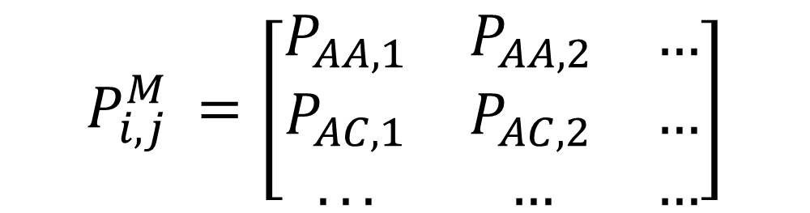

Markov Weight Array Matrix
1st order Markov WAM based on on the 1st order Markov chain
Computation of probabilities is the same as for the Positional Probabilities, except the alphabet is tuples (AA,AC,AG,AT,CA,....,TT), size=16
Let each tuple be . Estimate from the data probabilities for every ; for a pattern of length n, the matrix will have dimensions 16 by (n-1)
$$T_{i}$$
$$T_{i}$$
$$P_{i,j}^{M}$$
$${P_{i,j}^{M}}_{ }=\left[\begin{matrix}P_{AA,1} & P_{AA,2} & … \\ P_{AC,1} & P_{AC,2} & … \\ ... & … & …\end{matrix}\right]$$

Slide 6

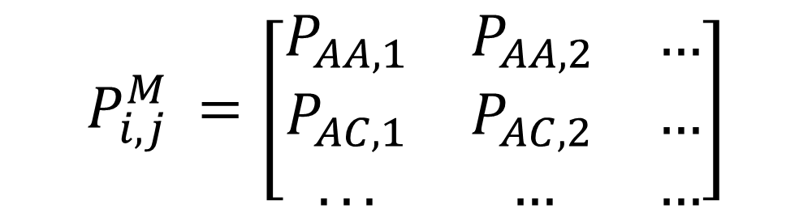
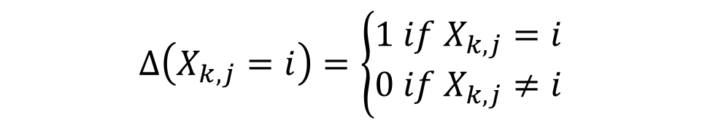
Markov Weight Array Matrix
$P_{i,j}^{M}=\frac{1}{N}\sum_{k=1}^{N}{∆(X_{k,j}=i)}, X^{′}s and i^{′}s$ are now AA,AC,AG,… etc
$$∆\left(X_{k,j}=i\right)=\left\{\begin{matrix}1 if{ X}_{k,j}=i \\ 0 if{ X}_{k,j}≠i\end{matrix}\right.$$
The idea is the same as for positional probabilities, but now you are working with tuples of letters: e.g. instead of counting how many times you’ve seen A, C, G or T in the first position, you count how many times you’ve seen AA, AC,…. in the first position, etc
$${P_{i,j}^{M}}_{ }=\left[\begin{matrix}P_{AA,1} & P_{AA,2} & … \\ P_{AC,1} & P_{AC,2} & … \\ ... & … & …\end{matrix}\right]$$

Slide 7
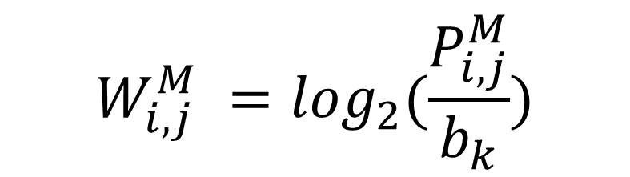
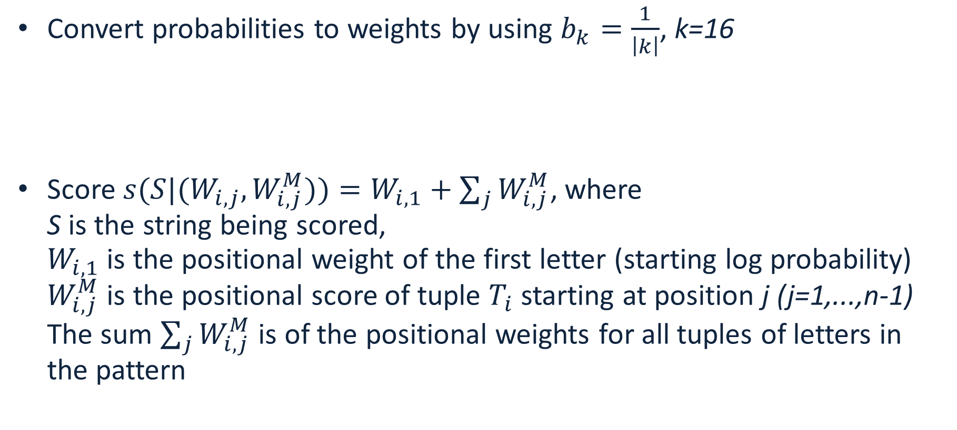
Scoring pattern with Markov WAM
Convert probabilities to weights by using $b_{k}=\frac{1}{\left|k\right|}$, k=16
Score ${s(S|(W}_{i,j},W_{i,j}^{M}))=W_{i,1}+\sum_{j}{W_{i,j}^{M}}$, where
S is the string being scored,
$W_{i,1}$ is the positional weight of the first letter (starting log probability)
$W_{i,j}^{M}$ is the positional score of tuple $T_{i}$ starting at position j (j=1,...,n-1) The sum $\sum_{j}{W_{i,j}^{M}}$ is of the positional weights for all tuples of letters in the pattern
$$W_{i,j}^{M} =\log_{2}(\frac{P_{i,j}^{M}}{b_{k}})$$

Slide 8
Estimation of negative hypothesis
Weight Array or Markov chain score is related to the probability that the Markov process(es) generated the pattern
One can compare it to the “negative” hypothesis -- score under a model trained on randomly chosen “invalid” patterns: genome sequences of length n that are not valid patterns
A reasonable assumption is that for the negative hypothesis all probabilities are the same, so the sum of the weights is 0 (zero), thus a score above zero indicates a match to the pattern
  Genomes with strong GC-bias (more G’s and C’s compared to A’s and T’s) fail that assumption

Slide 9
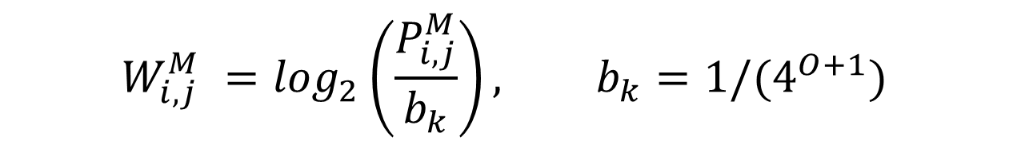
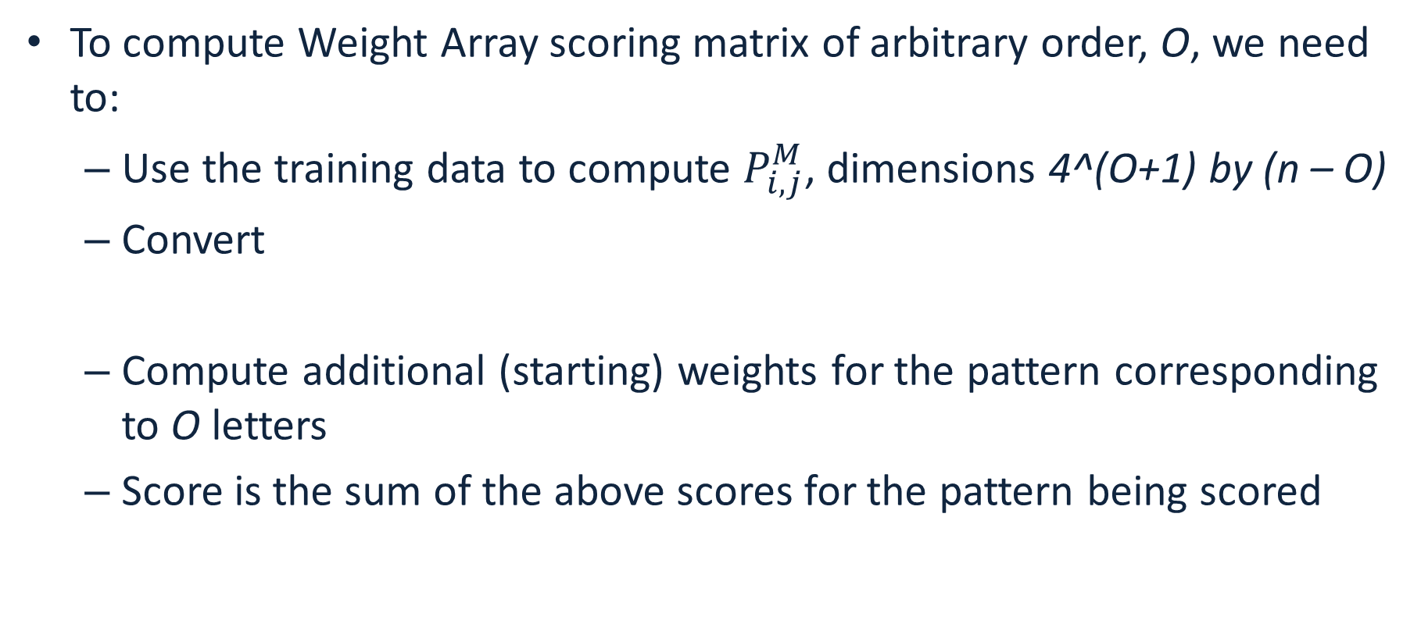
Extend to arbitrary order
To compute Weight Array scoring matrix of arbitrary order, O, we need to:
  Use the training data to compute $P_{i,j}^{M}$, dimensions 4^(O+1) by (n – O)
  Convert
  Compute additional (starting) weights for the pattern corresponding to O letters
  Score is the sum of the above scores for the pattern being scored
$$W_{i,j}^{M} =\log_{2}\left(\frac{P_{i,j}^{M}}{b_{k}}\right), b_{k}={1/(4}^{O+1})$$

Slide 10
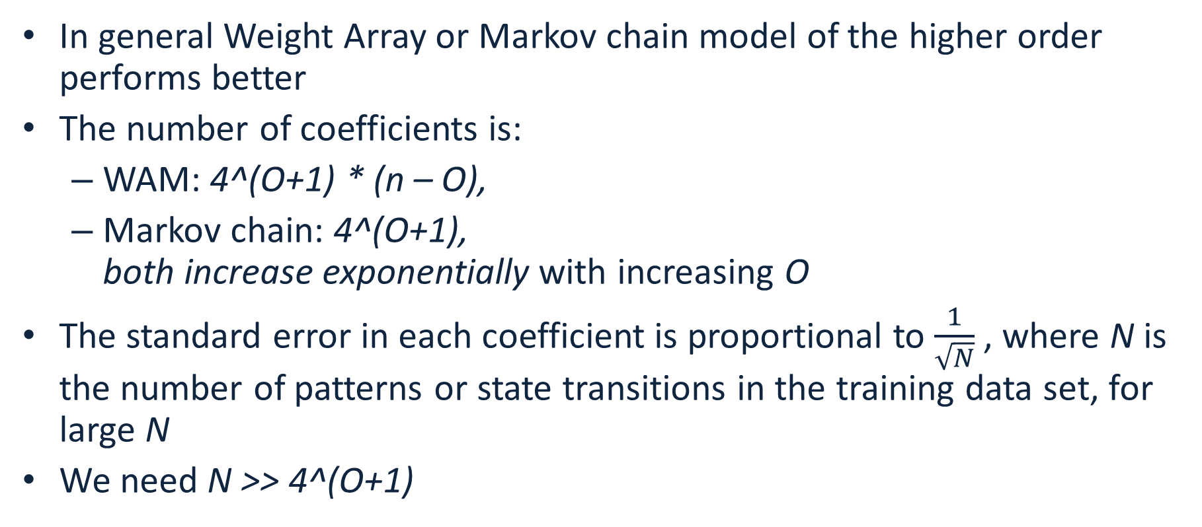
How to choose the order of Markov chain or WAM
In general Weight Array or Markov chain model of the higher order performs better
The number of coefficients is:
  WAM: 4^(O+1) * (n – O),
  Markov chain: 4^(O+1),
  both increase exponentially with increasing O
The standard error in each coefficient is proportional to $\frac{1}{\sqrt{N}}$, where N is the number of patterns or state transitions in the training data set, for large N
We need N >> 4^(O+1)

